Slide 1
BASIC NETWORK PROGRAMMING (LẬP TRÌNH MẠNG CƠ BẢN)
Introduction to Java Network Programmning
Basic File Operation with File Class

Slide 2
Introduction to Java Network Programmning

Slide 3
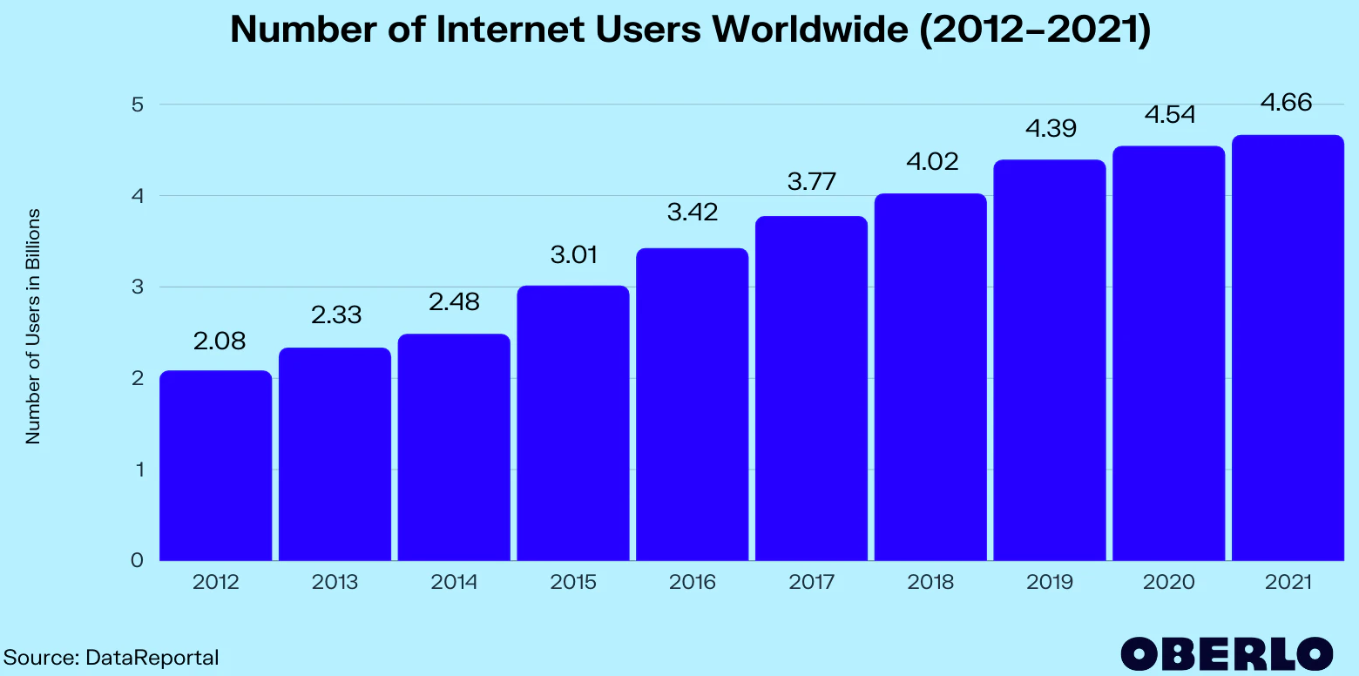
Introduction
Computer networking has grown explosively

Slide 4
Introduction
Since the 1970s, computer communication has changed from a research topic to an essential part of infrastructure
Networking is used in every aspect of our lives:
Business
Advertising
Production
Shipping
Planning
Billing
Accounting

Slide 5
Introduction
In short, computer networks are everywhere
In 1980, the Internet was a research project that involved a few dozen sites
Today, the Internet has grown into a communication system that reaches all of the world
Internet and WWW have emerged as global ubiquitous media for communication and changing the way we conduct science, engineering, and commerce.
They also changing the way we learn, live, enjoy, communicate, interact, etc. It appears like the modern life activities are getting completely centered around the Internet.

Slide 6

Internet Applications
PC client
Internet Server
Local Area Network
PDA / Smart Phone

Slide 7
Increased demand for Internet applications
To take advantage of opportunities presented by the Internet, businesses are continuously seeking new and innovative ways and means for offering their services via the Internet.
This created a huge demand for software designers with skills to create new Internet-enabled applications or migrate existing legacy applications on the Internet platform.
Object-oriented Java technologies: Sockets, Threads, RMI, Web services -- have emerged as leading solutions for creating portable, efficient, and maintainable large and complex Internet applications.

Slide 8
Elements of Client-Server Computing
a client, a server, and network
Request
Client
Server
Network
Result
Client machine
Server machine

Slide 9
Networking Basics
Applications Layer
Standard apps
HTTP
FTP
Telnet
User apps
Transport Layer
TCP
UDP
Programming Interface:
Sockets
Network Layer
IP
Link Layer
Device drivers
TCP/IP Stack
Application
(http,ftp,telnet,…)
Transport
(TCP, UDP,..)
Network
(IP,..)
Link
(device driver,..)

Slide 10
TCP Programming
TCP (Transport Control Protocol) is a connection-oriented protocol that provides a reliable flow of data between two computers.
When two applications want to communicate to each other reliably, they establish a connection and send data back and forth over that connection
TCP provides a point-to-point channel for applications that require reliable communications.
Example applications:
HTTP
FTP
SMTP / POP / IMAP
TCP/IP Stack
Application
(http,ftp,telnet,…)
Transport
(TCP, UDP,..)
Network
(IP,..)
Link
(device driver,..)

Slide 11
UDP Programming
TCP/IP Stack
UDP (User Datagram Protocol) is a protocol that sends independent packets of data, called datagrams, from one computer to another with no guarantees about arrival.
Example applications:
Clock server
Ping
Application
(http,ftp,telnet,…)
Transport
(TCP, UDP,..)
Network
(IP,..)
Link
(device driver,..)

Slide 12
Understanding Ports
The TCP and UDP protocols use ports to map incoming data to a particular process running on a computer.
server
P o r t
TCP
Client
app
app
app
app
port
port
port
port
TCP or UDP
Packet
Data
port#
data

Slide 13
Sockets and Ports
Client
port 13
Time Service
Web Service
port 80
Socket
Socket
Server

Slide 14
Well-Known Ports
20 : FTP (Data)
21 : FTP
23 : Telnet
25 : SMTP
43 : Whois
53 : DNS
80 : HTTP
110 : POP3
1099 : RMI

Slide 15
The World Wide Web
Runs on the Internet
Uses HTTP protocol
Invented by Tim Berners-Lee (and a cast of thousands)

Slide 16
URL
URL = Unique Resource Locator
protocol://host[:port][/path/][file][#anchor]
http://www.javasoft.com/sfaq/index.html
http://www.javasoft.com/sfaq/
ftp://ftp.stinky.com/pub/java/course.zip

Slide 17
HTTP
port 80 default
Client:
GET path HTTP/1.0
Header: value
blank line
Server:
HTTP/1.0 OK 200
Header: value
blank line
data
telnet demo again

Slide 18
Basic File Operation with File class

Slide 19
Java File and Folder
An abstract representation of file and directory pathnames.
For UNIX platforms, the prefix of an absolute pathname is always "/". Relative pathnames have no prefix.
For Microsoft Windows platforms, the prefix of a pathname that contains a drive specifier consists of the drive letter followed by ":" and possibly followed by "\\" if the pathname is absolute. A relative pathname that does not specify a drive has no prefix.
Examples:
“D:\\TMP\\t.txt”
“t.txt”

Slide 20
The java.io.File Class
public File(File parent, String child)
Creates a new File instance from a parent abstract pathname and a child pathname string.
public File(String parent, String child)
Creates a new File instance from a parent pathname string and a child pathname string.
public File(String pathname)
Creates a new File instance by converting the given pathname string into an abstract pathname. If the given string is the empty string, then the result is the empty abstract pathname.
public String getCanonicalPath ()
Returns the absolute and unique pathname string of this abstract pathname.

Slide 21
The java.io.File Class
public boolean exists()
Tests whether the file or directory denoted by this abstract pathname exists.
public boolean isDirectory()
Tests whether the file denoted by this abstract pathname is a directory.
public boolean isFile()
Tests whether the file denoted by this abstract pathname is a normal file.
public long length()
Returns the length (the zise in Kbyte) of the file denoted by this abstract pathname.

Slide 22
The java.io.File Class
public boolean delete()
Deletes the file or directory denoted by this abstract pathname. If this pathname denotes a directory, then the directory must be empty in order to be deleted.
public String[] list()
Returns an array of strings naming the files and directories in the directory denoted by this abstract pathname.
public String[] list(FilenameFilter filter)
Returns an array of strings naming the files and directories in the directory denoted by this abstract pathname that satisfy the specified filter.If the given filter is null then all names are accepted.

Slide 23
The java.io.File Class
public File[] listFiles()
Returns an array of abstract pathnames denoting the files in the directory denoted by this abstract pathname.
public File[] listFiles(FilenameFilter filter)
Returns an array of abstract pathnames denoting the files and directories in the directory denoted by this abstract pathname that satisfy the specified filter.
public boolean mkdir()
Creates the directory named by this abstract pathname.
public boolean mkdirs()
Creates the directory named by this abstract pathname, including any necessary but nonexistent parent directories.

Slide 24
The java.io.File Class
public boolean isAbsolute()
Tests whether this abstract pathname is absolute.
public boolean canRead()
Tests whether the application can read the file denoted by this abstract pathname.
public boolean canWrite()
Tests whether the application can modify the file denoted by this abstract pathname
public boolean isHidden()
Tests whether the file named by this abstract pathname is a hidden file.

Slide 25
The java.io.File Class
//List of all files in D: with extention tgz ???
import java.io.*;
import java.util.*;
public class DLister {
public static void main(String[] args) {
File path = new File("D:\\");
String[] list;
list = path.list(new DirFilter(".tgz"));
for(int i = 0; i < list.length; i++)
System.out.println(list[i]);
} }
class DirFilter implements FilenameFilter {
String afn;
DirFilter(String afn) { this.afn = afn; }
public boolean accept(File dir, String name) {
String f = new File(name).getName();
return f.indexOf(afn) != -1;
} }

Slide 26
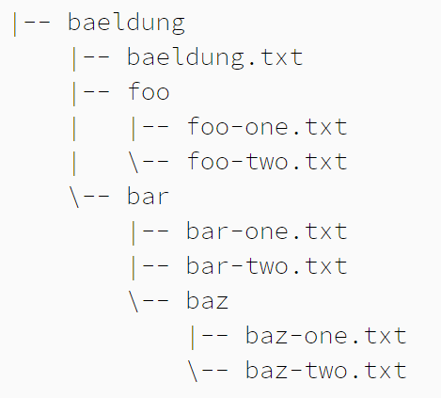
Comparing getPath methods
getPath(), getAbsolutePath(), getCanonicalPath()
Ref: https://www.baeldung.com/java-path

Slide 27
Comparing getPath methods
File file = new File("foo/foo-one.txt");
file.getPath()
foo/foo-one.txt // on Unix systems
foo\foo-one.txt // on Windows systems
file.getAbsolutePath()
/home/username/baeldung/foo/foo-one.txt // Unix
C:\Users\username\baeldung\foo\foo-one.txt // Win
file.getCanonicalPath()
/home/username/baeldung/bar/bar-one.txt // Unix
C:\Users\username\baeldung\bar\bar-one.txt // Win

Slide 28
Comparing getPath methods
File file = new File("bar/baz/../bar-one.txt");
file.getPath()
foo/foo-one.txt // on Unix systems
foo\foo-one.txt // on Windows systems
file.getAbsolutePath()
/home/username/baeldung/bar/baz/../bar-one.txt //U
C:\Users\username\baeldung\bar\baz\..\bar-one.txt //W
file.getCanonicalPath()
/home/username/baeldung/bar/baz/baz-one.txt // Unix
C:\Users\username\baeldung\bar\baz\baz-one.txt // W

Slide 29
Exercise
public boolean deleteDir(String path)
public boolean find(String path, String filePattern)
public boolean find(String path, String pattern)

